Slide 1


Slide 2
[03]
The Ecosystem

Slide 3
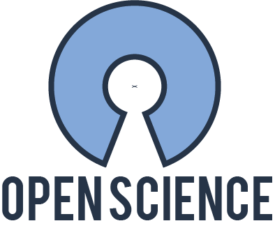
[03] The Ecosystem
How can we generate real world evidence in a reliable way?
It must be “reproducible”
The result should generalize through different geographies and clinical realities
Data must be interoperable
Analysis should yield similar results
How do we all store data in the same format? How do we share methods ?

Slide 4
[03] The Ecosystem
Open Science is sustained by individual with similar goals
No single Company can develop and validate the analytical methods.
No single Lab can maintain the vocabularies.
No Hospital has resources to adapt to every data request.
Community efforts are necessary to standardize the process. A true global effort

Slide 5

[03] The Ecosystem
OHDSI - A global Open Science community
Is a community of epidemiologist, biostatisticians, computer scientists […] founded in 2013
We build:
The specifications for data
The tools to work with data
The tools to analyze data
The methodologies to provide reliable evidence
Data is governed by each entity, NO data sharing, only methods and results

Slide 6
[03] The Ecosystem
OHDSI - A global Open Science community
Mission
To improve health by empowering a community to collaboratively generate the evidence that promotes better health decisions and better care.
Vision
A world in which observational research produces a comprehensive understanding of health and disease.

Slide 7
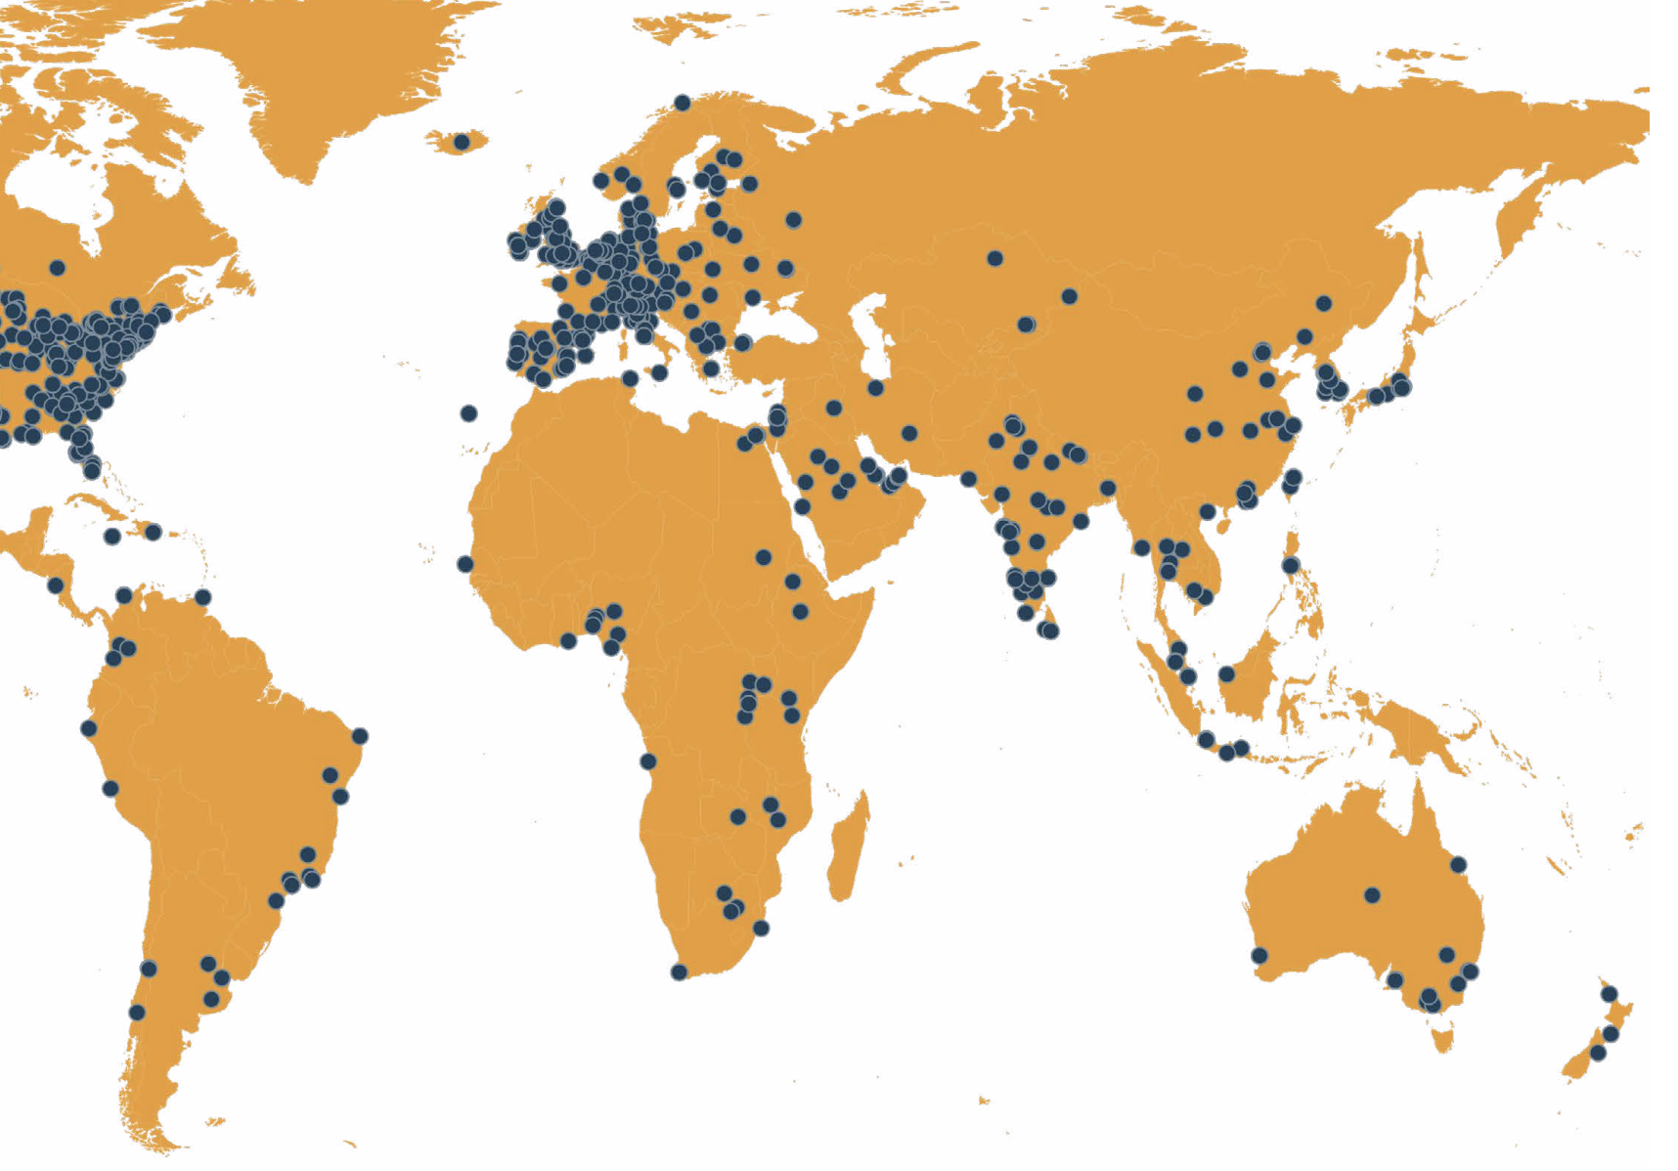
[03] The Ecosystem
OHDSI - By The Numbers
+1.000 M patients
+ 5,000 collaborators
544 data holders
88 countries
21 time zones
6 continents
1 community

Slide 8
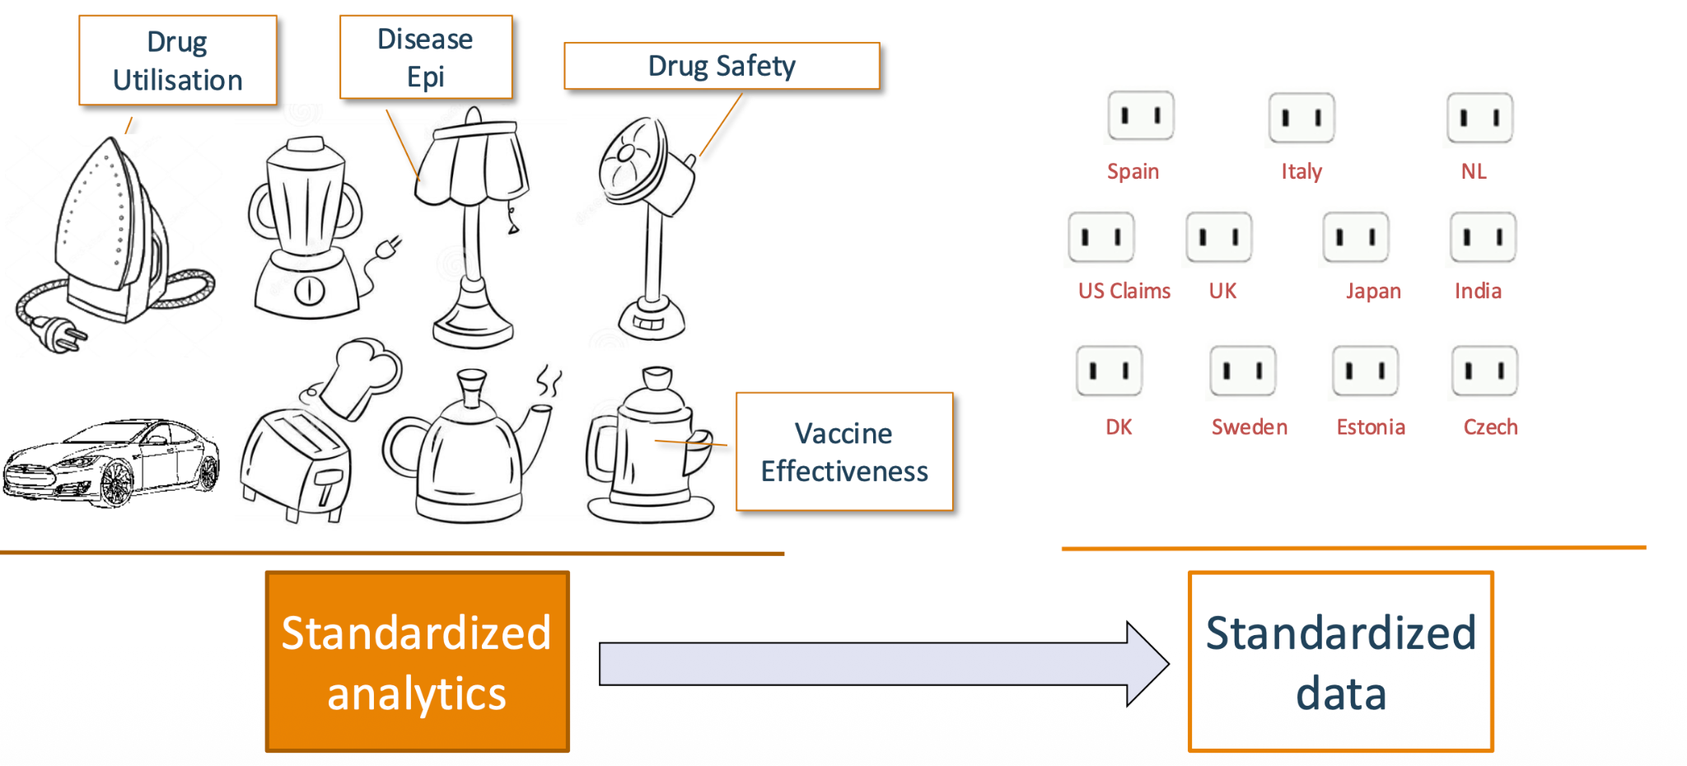
[03] The Ecosystem
The data and the methods must be standardized to be reproducible

Slide 9
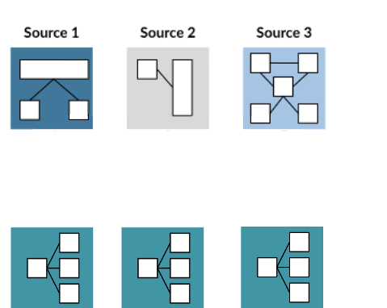
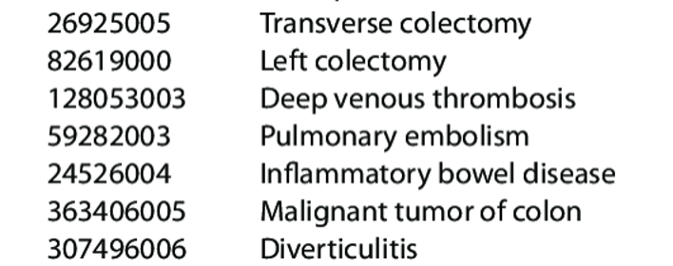
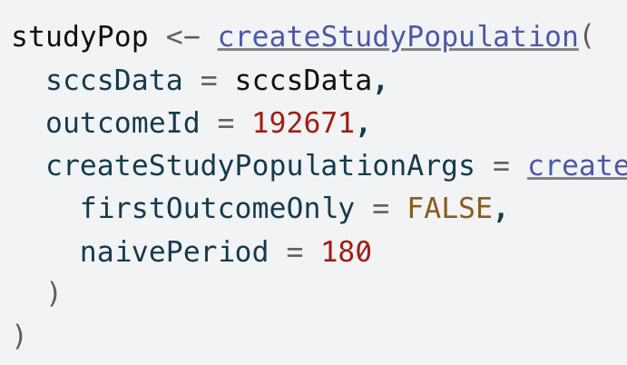
[03] The Ecosystem
At OHDSI we build together and learn from each other
Sharing data specifications, vocabularies, tools and methodologies we can focus on the clinical outcomes.
Multiple Hospital
For every clinical event
For every analysis
Same data model
A shared ID between all databases
Shared methodology

Slide 10
[03] The Ecosystem
At OHDSI we build together and learn from each other
Sharing data specifications, vocabularies, tools and methodologies we can focus on the clinical outcomes.
Data is governed by each entity, NO data sharing, only methods and results

Slide 11
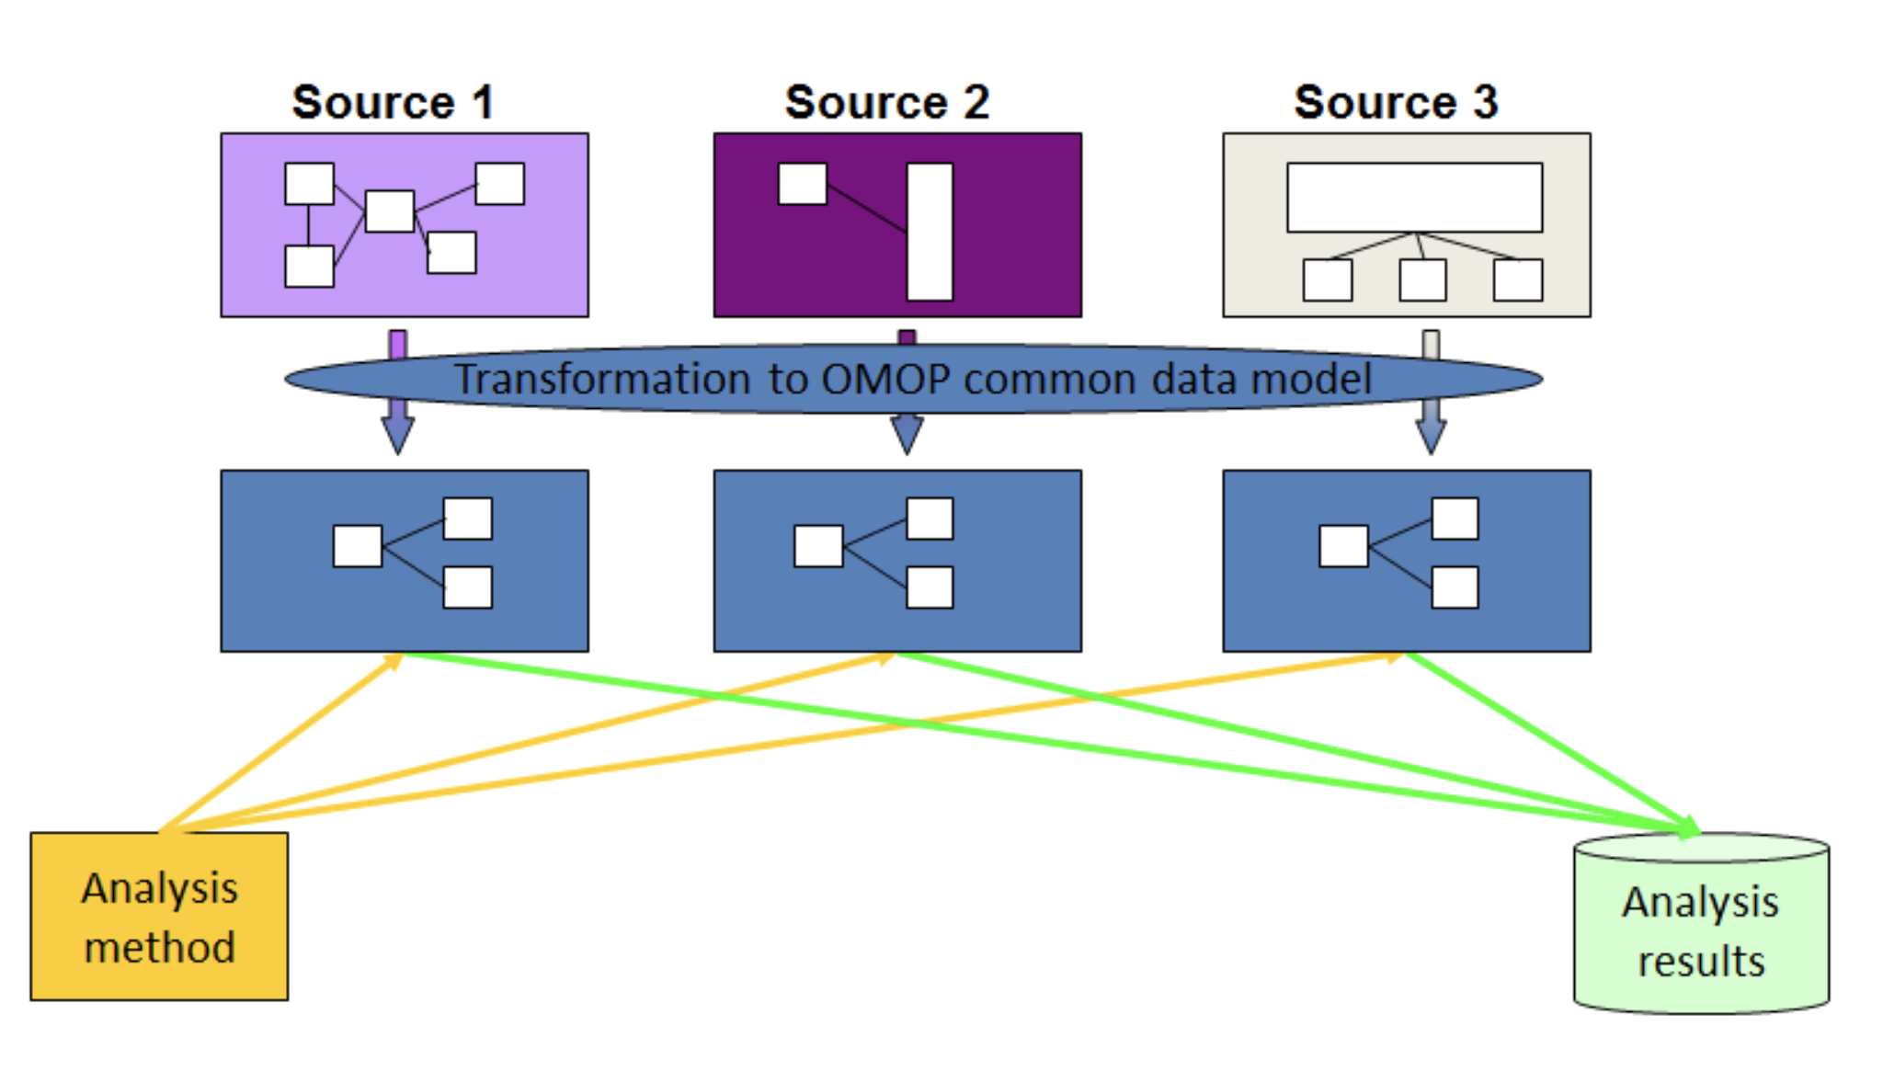
[03] The Ecosystem
By having standards, we can federate our clinical research, while data stays local to each source (Hospital)
Data Holder
Researchers
PLD

Slide 12
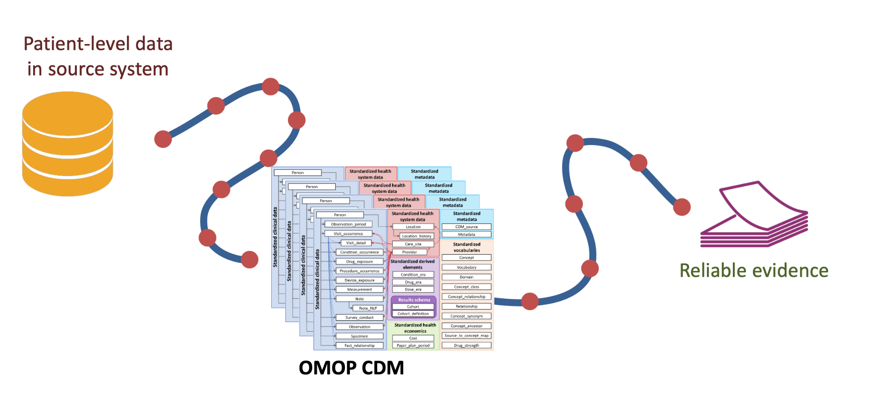
[03] The Ecosystem
At OHDSI we build together and learn from each other

Slide 13
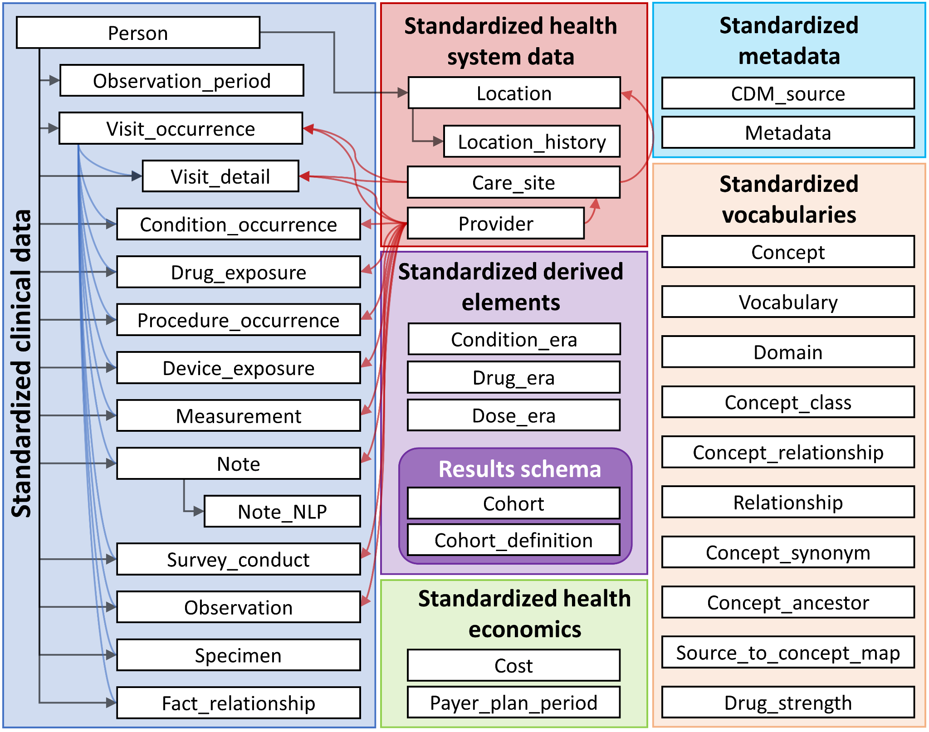
[03] The Ecosystem
OHDSI - OMOP Common Data Model

Slide 14
[03] The Ecosystem
OHDSI - OMOP Common Data Model
DEMO

Slide 15
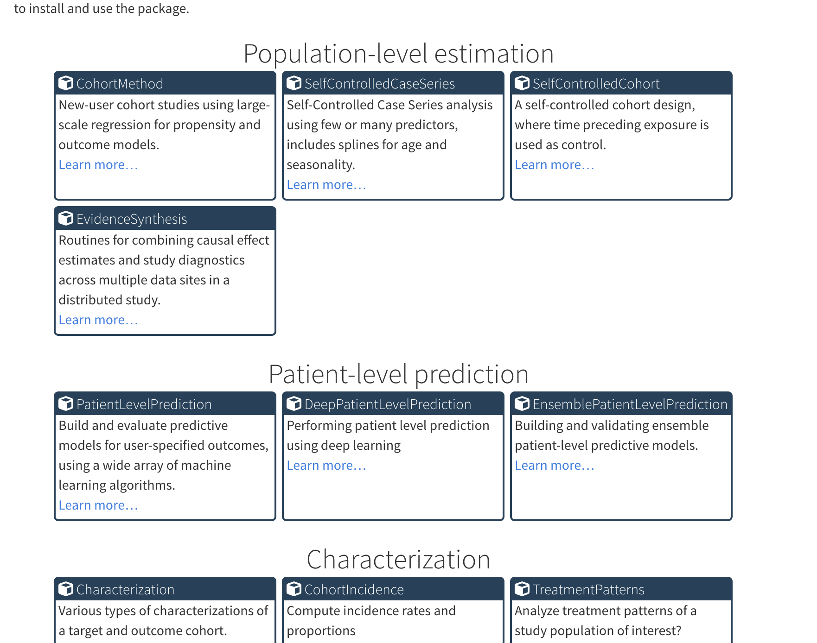
[03] The Ecosystem
OHDSI - Open Source analysis software

Slide 16





[03] The Ecosystem
From open innovation to regulation
Born from the Open-science Data Standard
European Foundational Pilot on the OHDSI Data Standardization
The Data Standard chosen by the European Medicines Agency
Regulation of the European Health Data Space (EHDS)
IOMED BORN
[ 2016 ]
[ TODAY ]
2014
2018
2021
2027

Slide 17
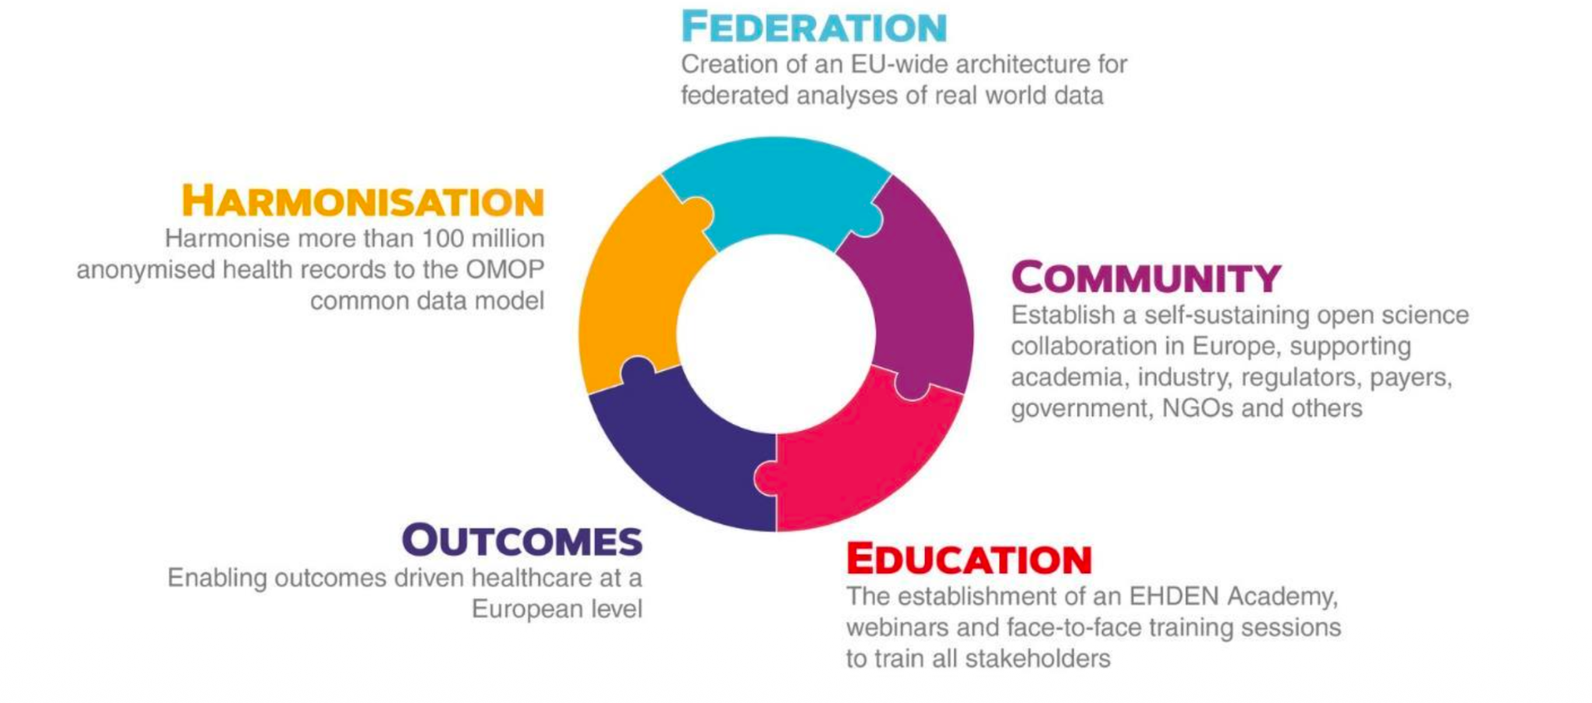
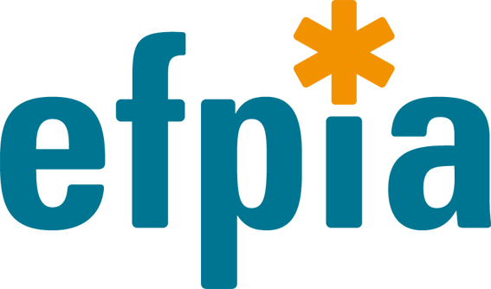

[03] The Ecosystem
EHDEN - The European proof of concept for scalable RWE
Proof of a new paradigm for the discovery and analysis of health data in Europe by building a large-scale, federated network of data sources standardised to a common data model (OMOP), significantly speeding up the generation of reliable evidence.

Slide 18
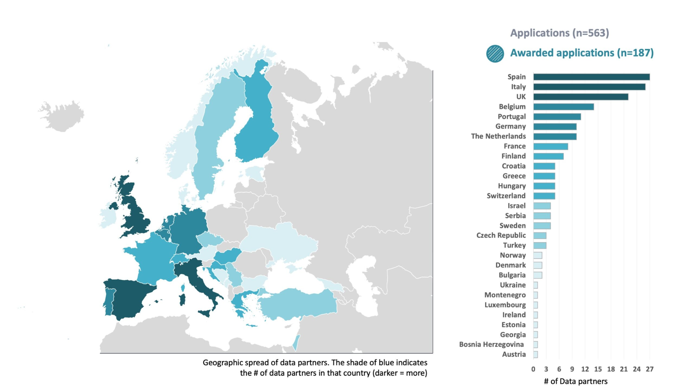
[03] The Ecosystem
EHDEN - The European proof of concept for scalable RWE

Slide 19
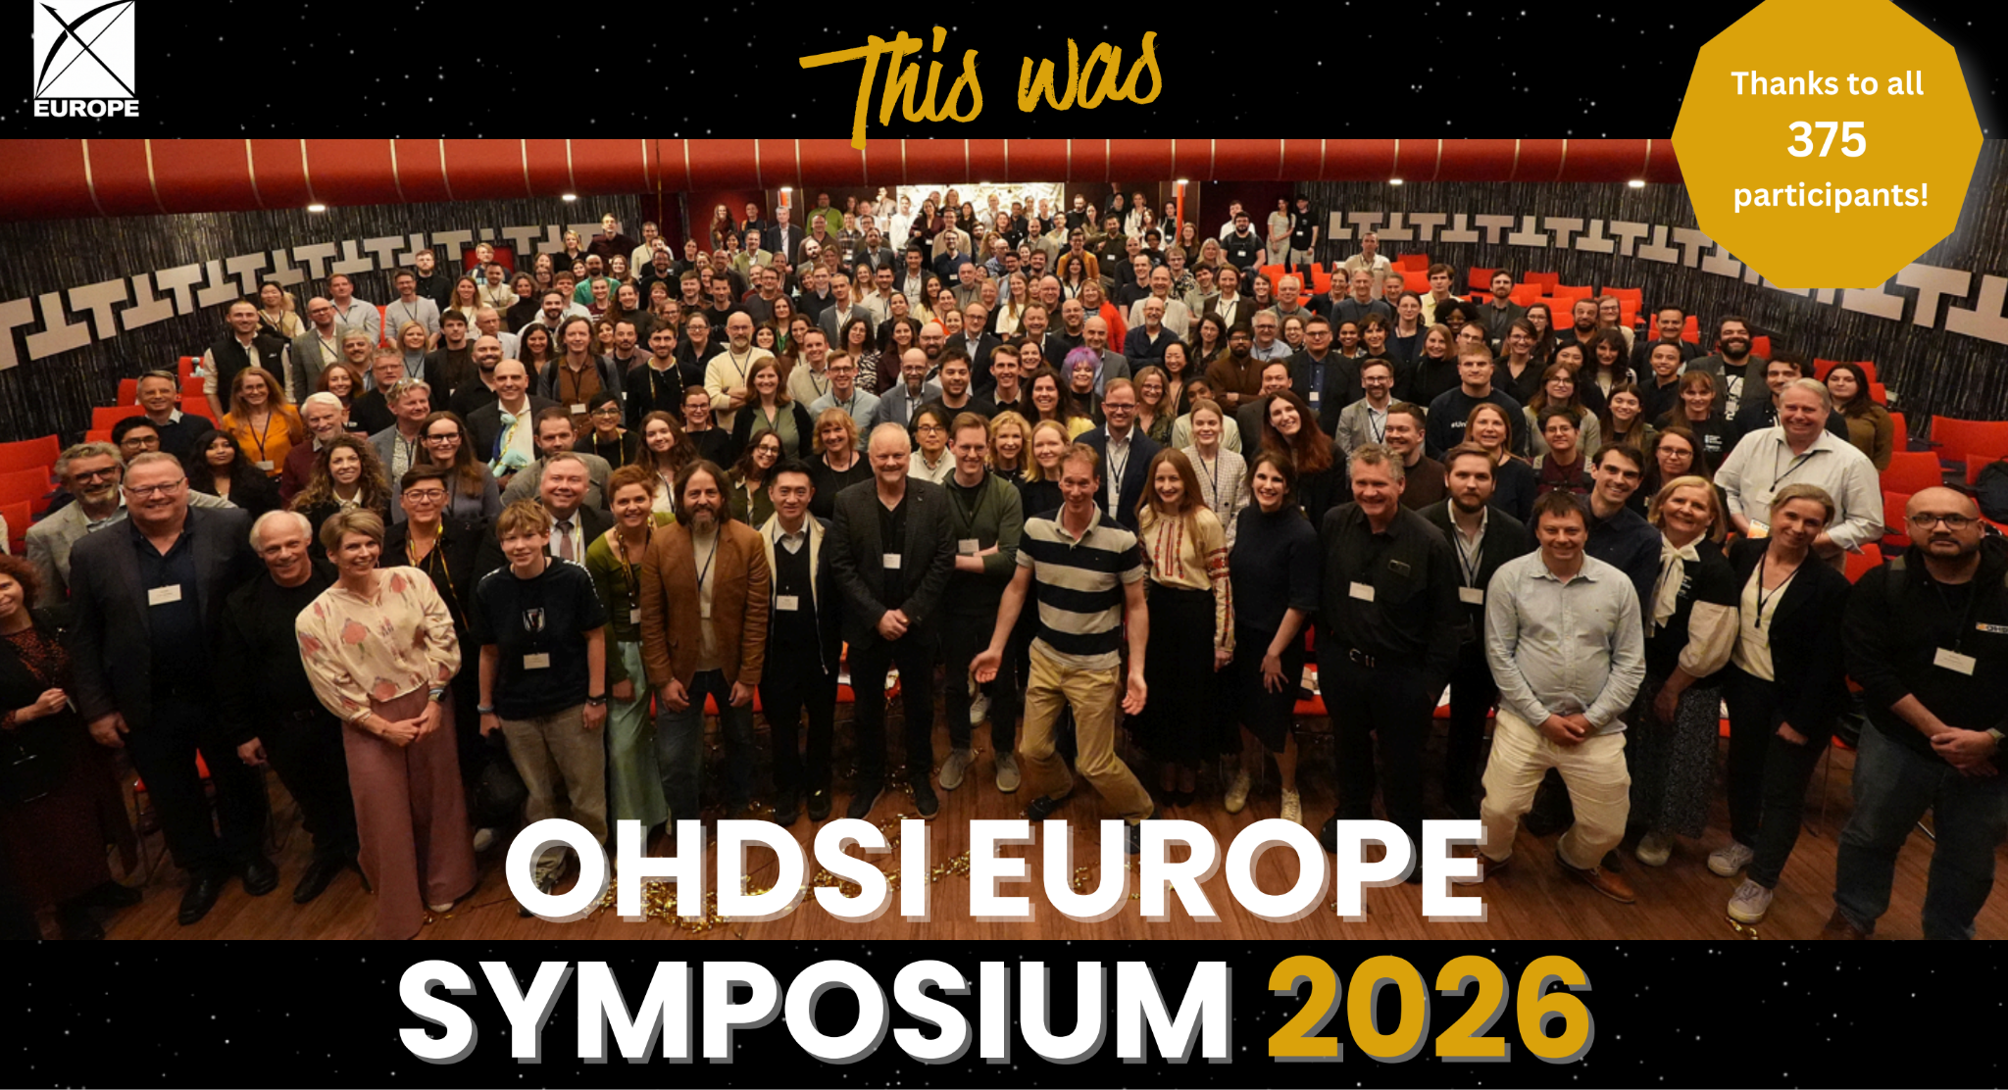
[03] The Ecosystem
EHDEN - The European proof of concept for scalable RWE

Slide 20
[03] The Ecosystem
From open innovation to regulation
Born from the Open-science Data Standard
European Foundational Pilot on the OHDSI Data Standardization
The Data Standard chosen by the European Medicines Agency
Regulation of the European Health Data Space (EHDS)
IOMED BORN
[ 2016 ]
[ TODAY ]
2014
2018
2021
2027

Slide 21
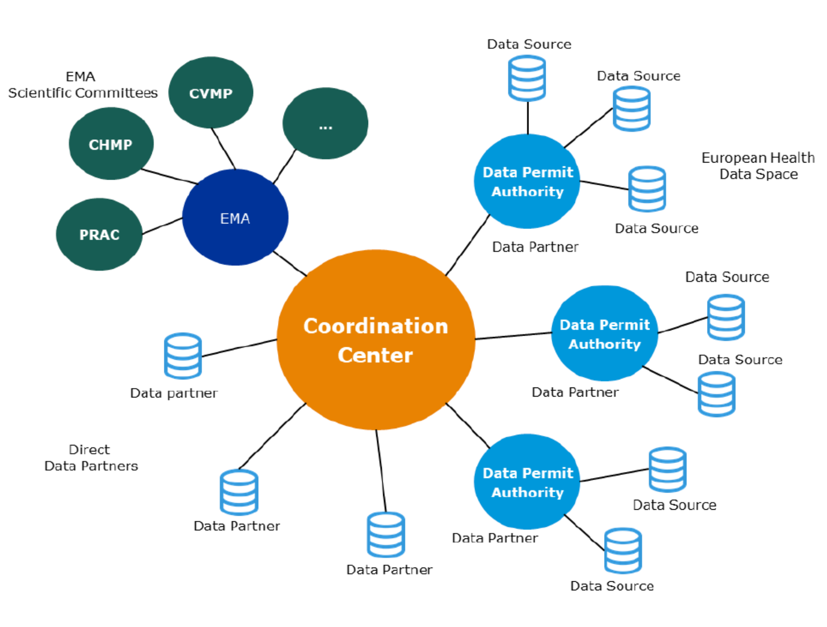
[03] The Ecosystem
DARWIN EU - The EMA RWE network
DARWIN EU® is a federated network of data, expertise and services that supports better decision-making throughout the product lifecycle by generating reliable evidence from real world healthcare data.

Slide 22
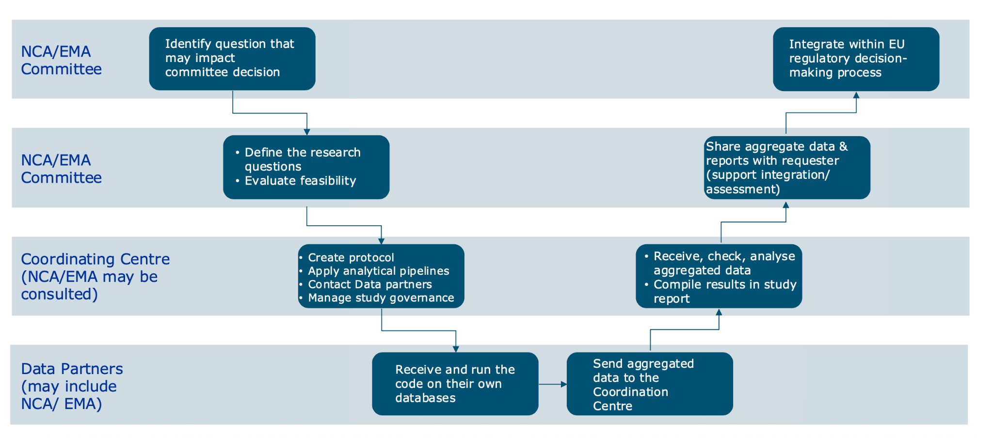
[03] The Ecosystem
DARWIN EU - The process for conducting studies

Slide 23
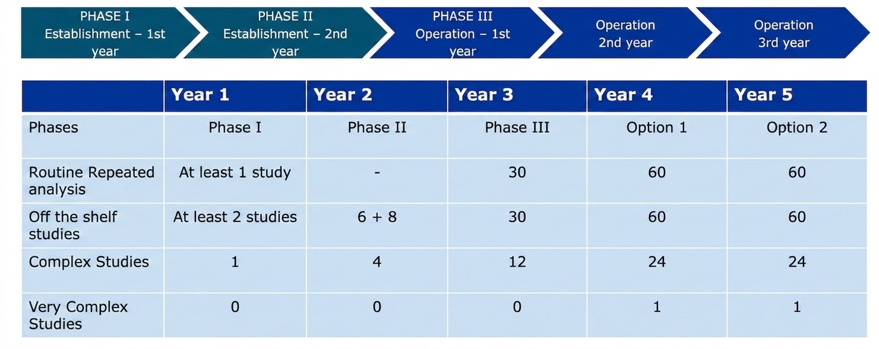
[03] The Ecosystem
DARWIN EU - The process for conducting studies

Slide 24
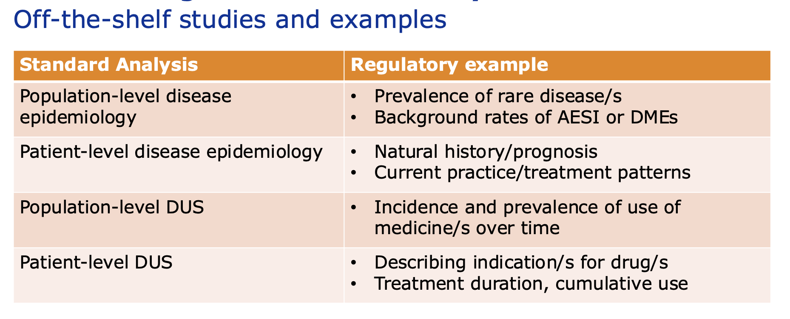
[03] The Ecosystem
DARWIN EU - The process for conducting studies

Slide 25
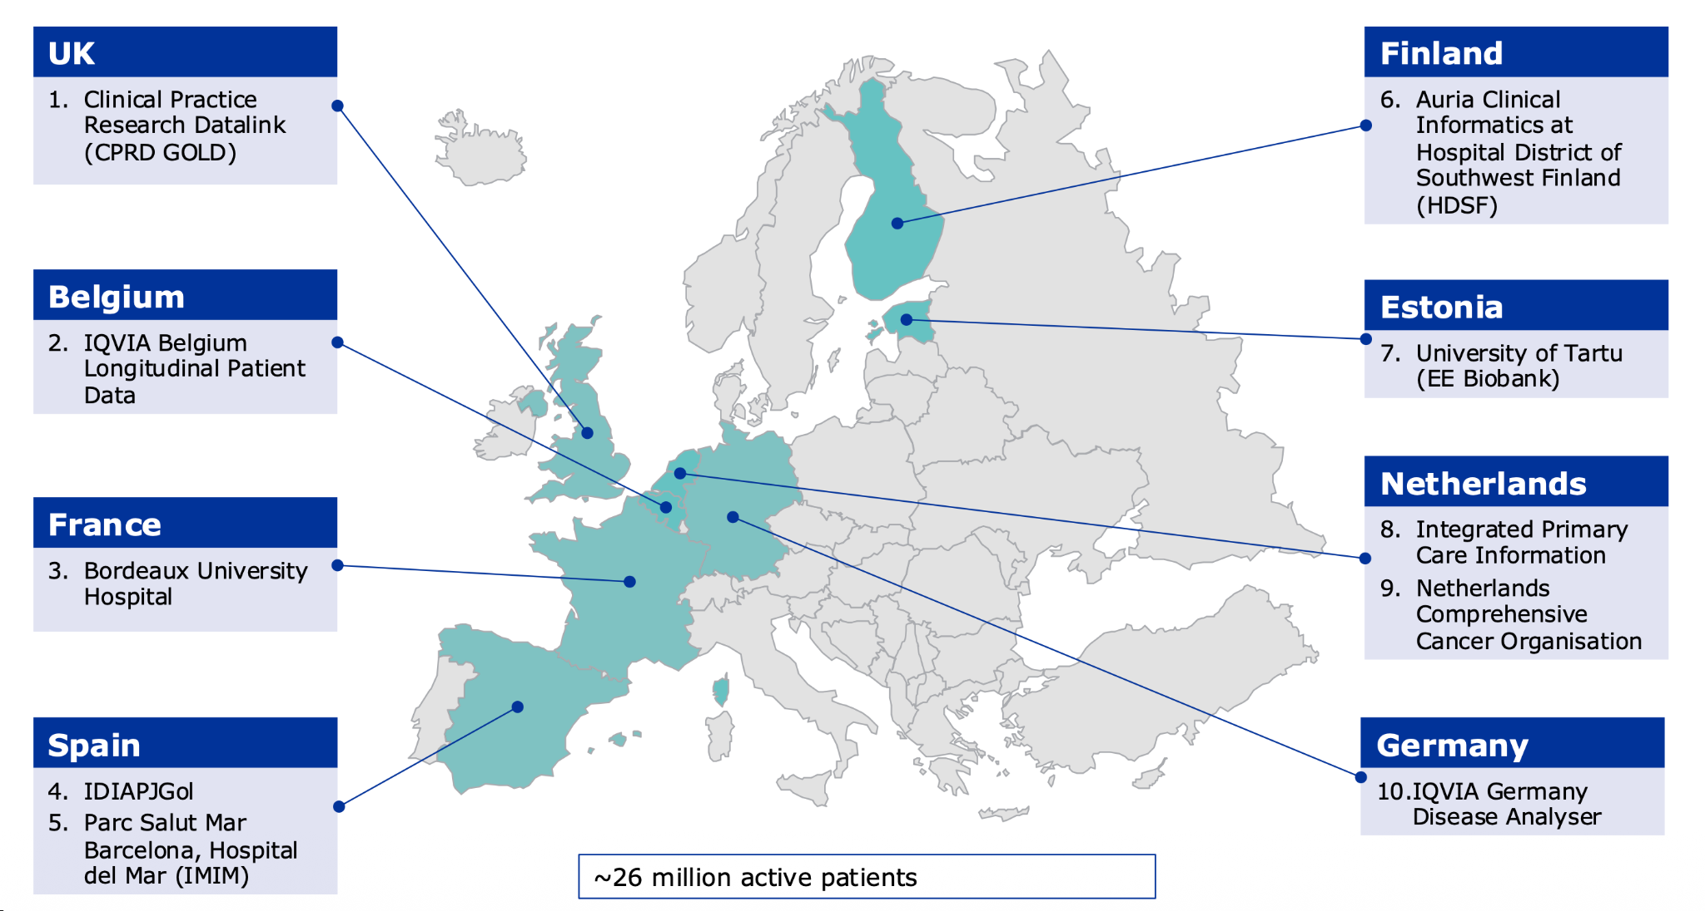
[03] The Ecosystem
DARWIN EU - Data Partners Phase 1

Slide 26
[03] The Ecosystem
DARWIN EU - v2
The established DARWIN initiative operated for five years.
This year, a new call for proposals will be launched, and new data partners will be engaged by DARWIN EU - v2.

Slide 27
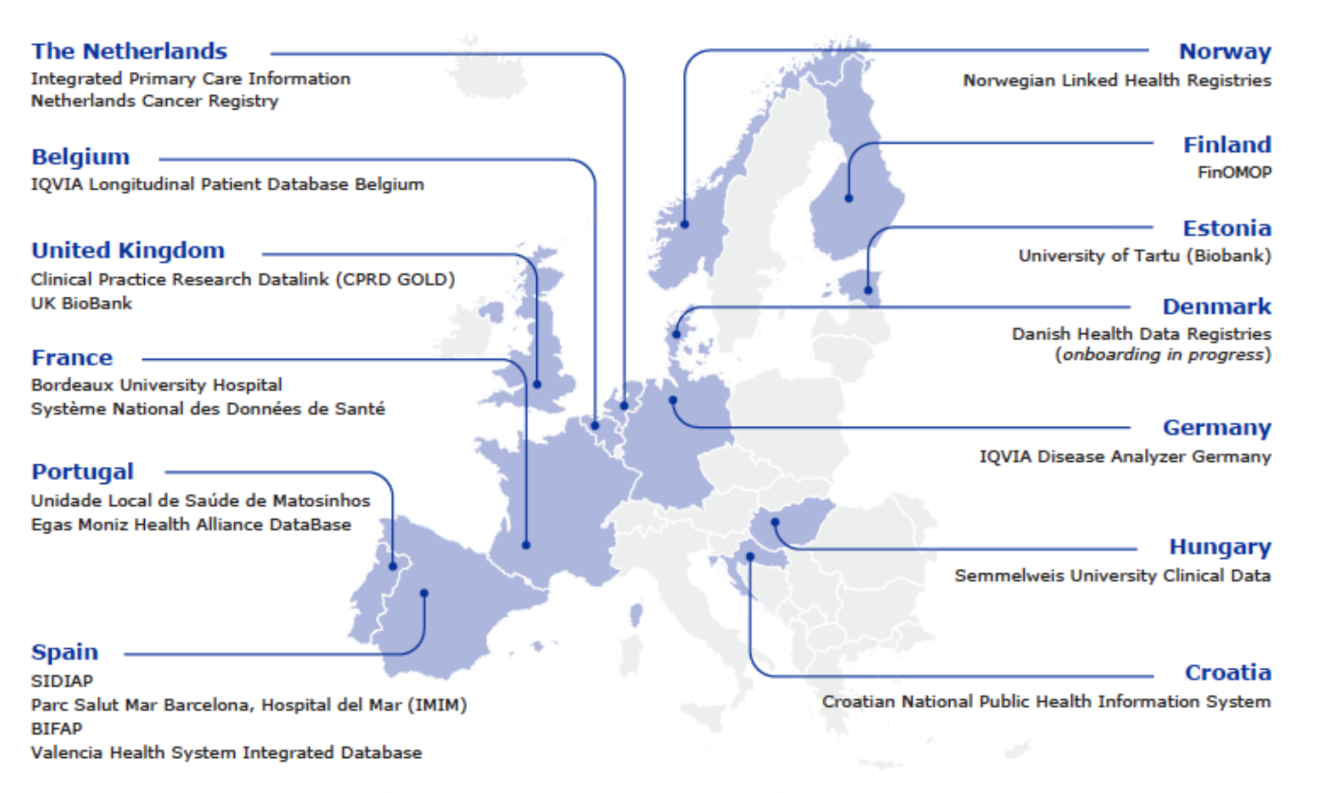
[03] The Ecosystem
DARWIN EU - Data Partners Phase 2

Slide 28
[03] The Ecosystem
From open innovation to regulation
Born from the Open-science Data Standard
European Foundational Pilot on the OHDSI Data Standardization
The Data Standard chosen by the European Medicines Agency
Regulation of the European Health Data Space (EHDS)
IOMED BORN
[ 2016 ]
[ TODAY ]
2014
2018
2021
2027

Slide 29
[03] The Ecosystem
European Health Data Space - An overview
The EHDS aims to foster a single market for digital health services and to improve the efficiency and quality of healthcare throughout the EU.
MyHealth@EU
An infrastructure to support the cross-border exchange of personal health data for direct care.
HealthData@EU A infrastructure designed to support the secondary use of data for research and analysis.

Slide 30
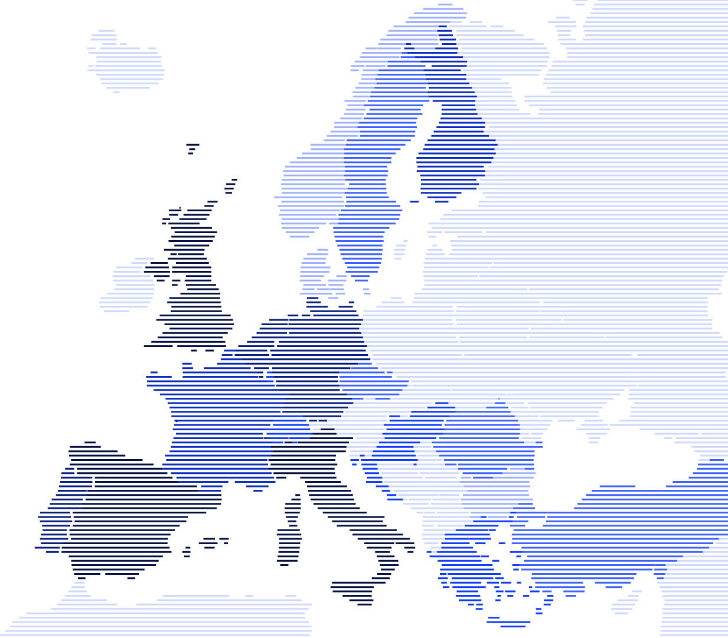
[03] The Ecosystem
Key features of European Health Data Space
A LEGAL FRAMEWORK TO BUILD A FEDERATED INFRASTRUCTURE TO ENABLE SECURE CROSS-BORDER REUSE OF ELECTRONIC HEALTH DATA FOR RESEARCH, POLICYMAKING AND INNOVATION.
[01] Data Interoperability
EHDS wants to ensure that health data systems across EU countries can communicate effectively, allowing for comprehensive access to patient records.
[02] Data Privacy & Security
Structured in alignment with the EU’s data protection standards, specifically the GDPR.
[03] Facilitating Data Access
Provides a framework for easier access to health data for healthcare providers, researchers, and policymakers.

Slide 31
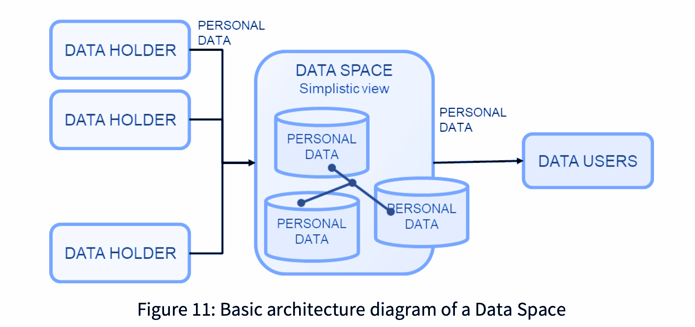
[03] The Ecosystem
European Health Data Space - An overview
Data Subjects
Individuals whose health data is managed.
Data Holders
Entities like hospitals that store and manage health data.
Data Space Mediators
Facilitate data exchange and ensure compliance.
Data Users
Researchers and policymakers utilizing health data.

Slide 32
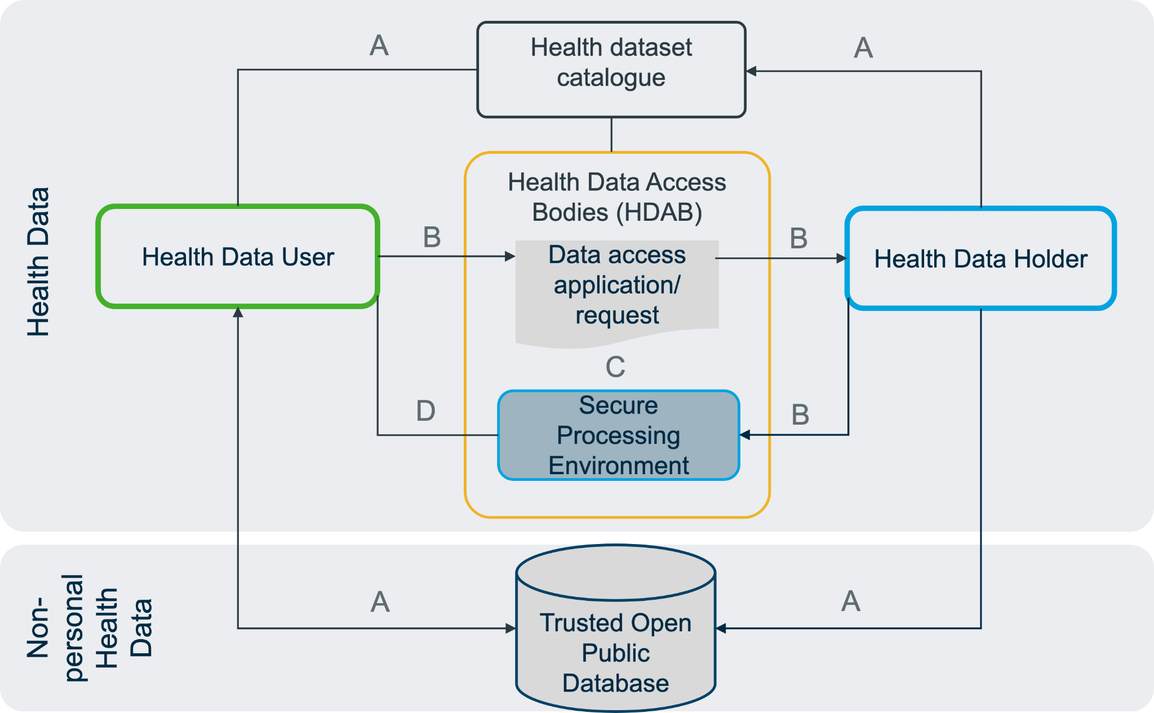
The future of healthcare
EHDS is now a reality with HealthData@EU public release
TARGET TO BE FULLY OPERATIONAL BY 2028

Slide 33




Who We Are
We provide the platform for the Health Data Infrastructure
Data Subjects
Individuals whose health data is managed.
Data Holders
Entities like hospitals that store and manage health data.
Data Request
Governance
Data Space Platform
Data Space Enabler, helping healthcare organizations make their data usable for research and innovation, and Data Space Mediation Infrastructure, connecting data holders and users to collaborate on research.
Data Catalogue
Data Request
Data Users
Researchers and policymakers utilizing health data.
AEPD on APPROACH TO DATA SPACES FROM GDPR PERSPECTIVE

Slide 34
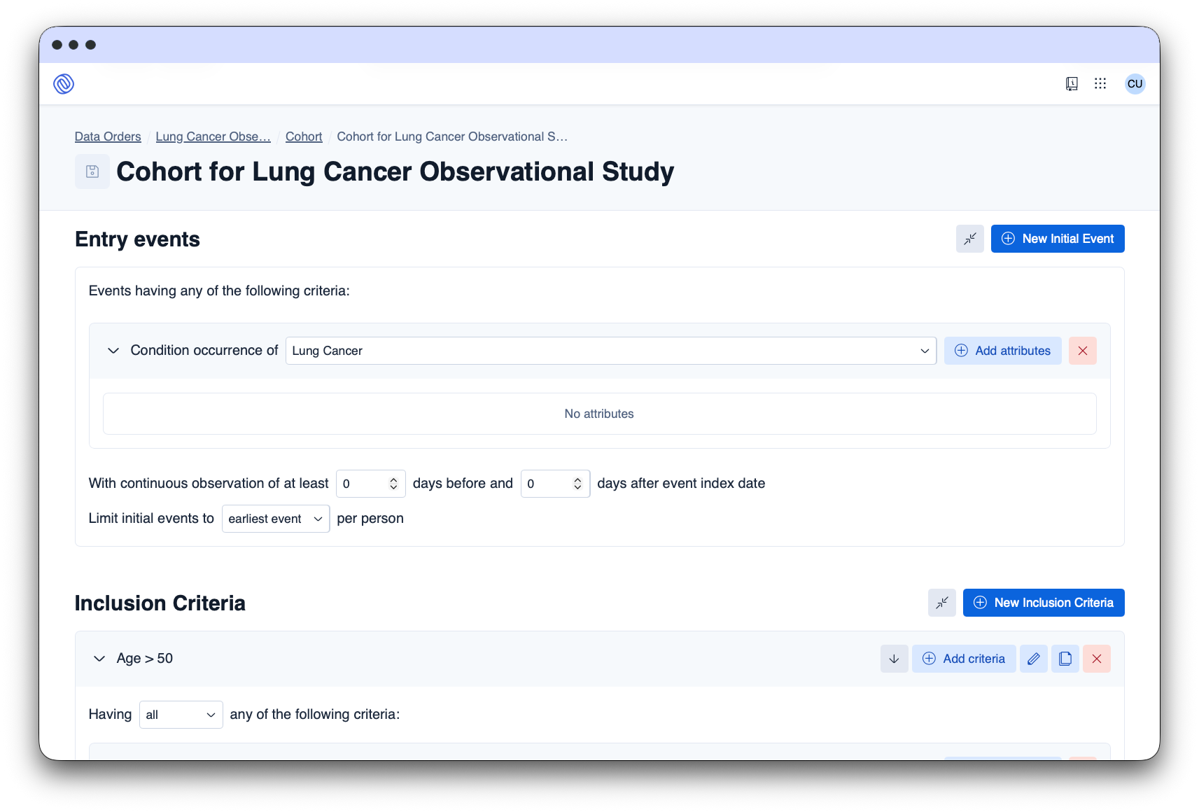
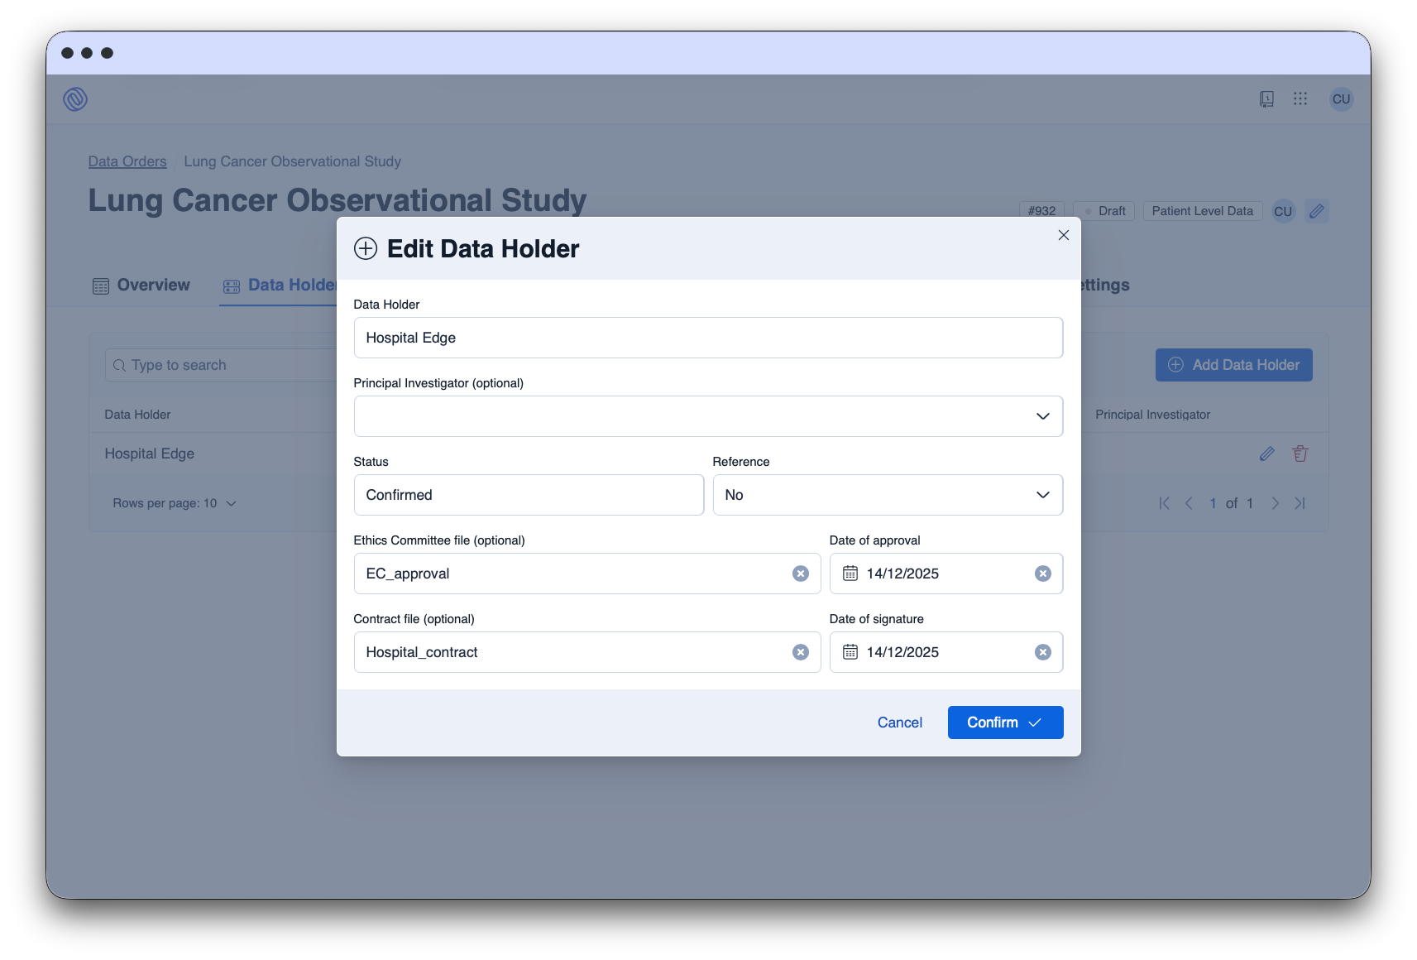
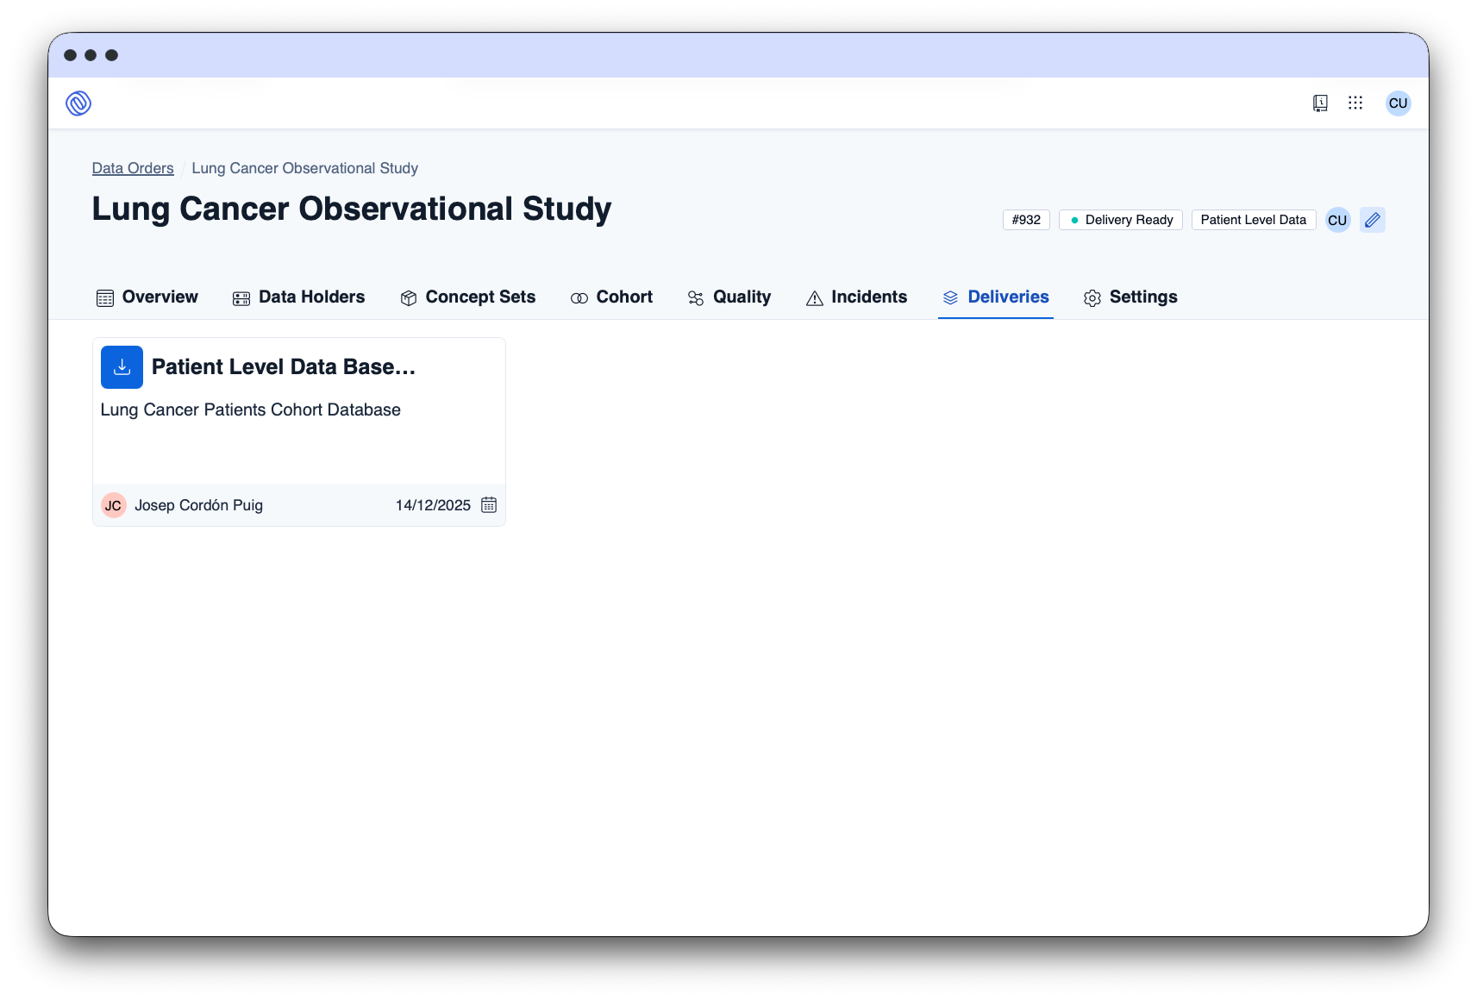
What We Do
Data Space Platform
A health data platform, created to mediate for secondary use of data, ensuring compliance.
By leveraging multimodal generative AI and integrating unstructured hospital data, IOMED Data Space Platform is a powerful tool to enhance the efficiency, precision, and success of clinical research efforts.
[01] Request
[02] Approval
HEOR | MED AFFAIRS | SAFETY
[03] Delivery

Slide 35
[04]
OMOP CDM Foundations

Slide 36
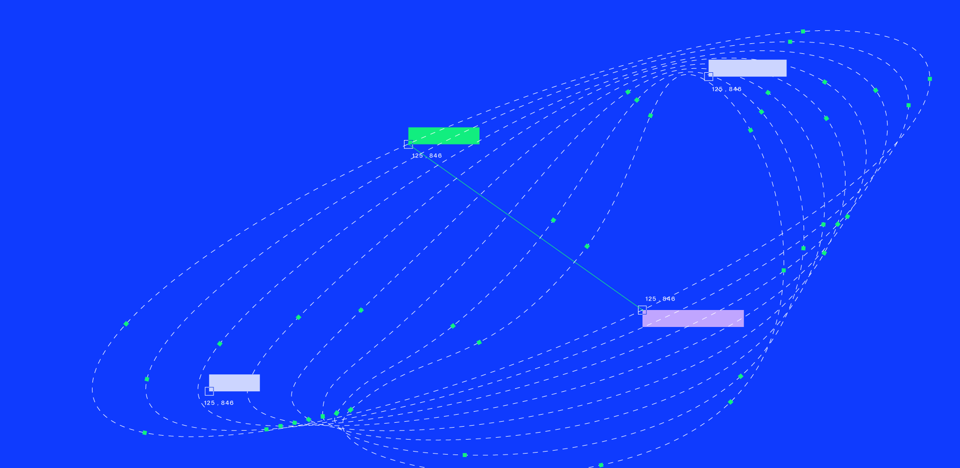

C/ de St. Antoni Maria Claret, 167, Sant Leopold Pavillion, 08025 — Barcelona
info@iomed.health
IOMED.HEALTH

